Slide 1
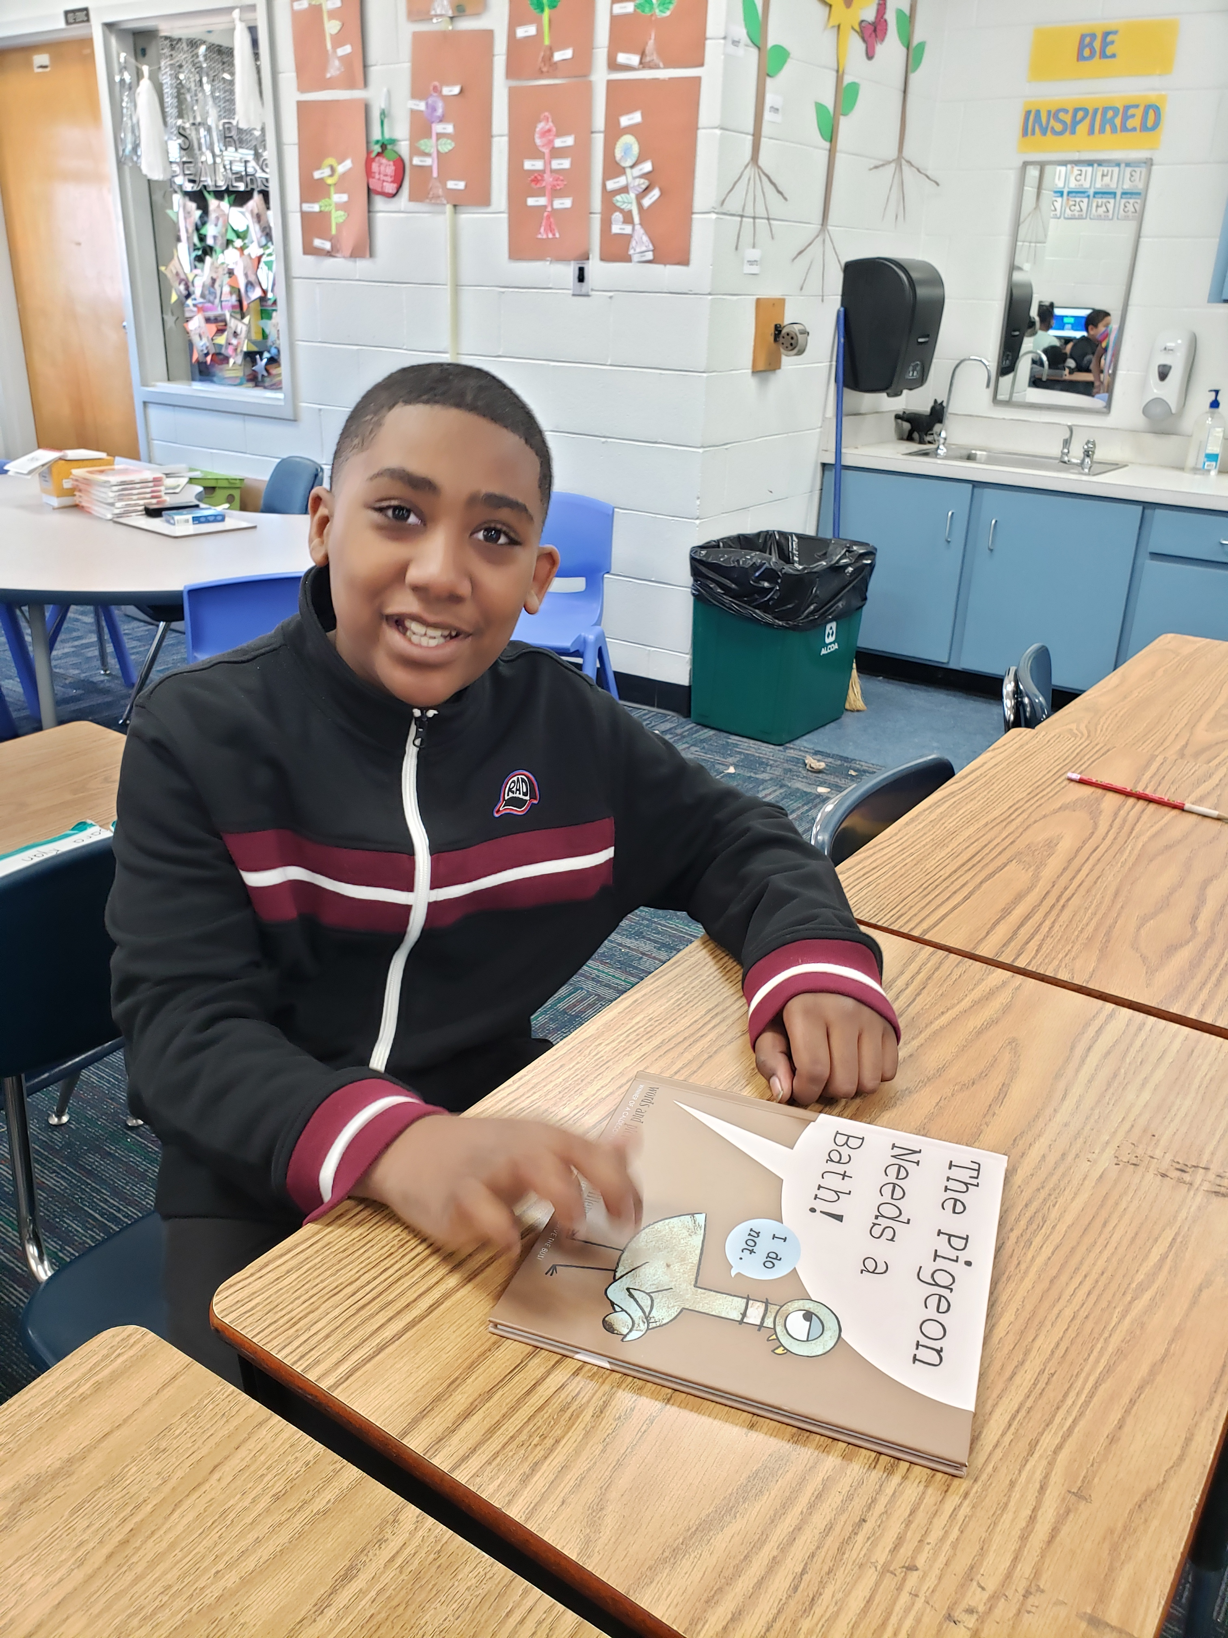
Keyotte Shaw
Astoria Park 2020 5th Grade Graduate

